Slide 1
Sign Language Translation
Princessosse Irabor
Benjamin Sullins

Slide 2
Overview
Concept
Technical Game Plan
Technical Implementation
Notes:
We’ll be hitting upon three main topics during this presentation.
The first is the general Concept of the project, the second is the top-level Technical attack plan, and lastly we’ll take a deep dive into the overall implementation of the processing stream.

Slide 3




Concept
Convert Sign Language Images Into Readable Characters Using Image Processing Techniques
Image Processing
Document

Slide 4
Technical Game Plan

Slide 5
Technical Game Plan
Part 1
Computer Generated Inputs
Initial Algorithm Testing
Part 2
Real Image Inputs
Modified (Extended) Algorithms
Notes:
If we wanted to talk a little about “how” we are going to accomplish this task, we’d be speaking about our Technical Game Plan.
We’ll begin by accumulating a test set of synthetic images that can be found online.
These synthetic images will be the initial strain gauge on the algorithms developed and help in understanding the complexities of the problem.
We’ll then transition those synthetic images to real-world images from a camera. Part two will consist of modifying, or extending, the original algorithms to something which is more robust.

Slide 6
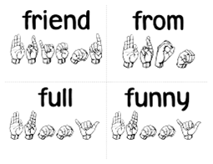
Technical Game Plan
Part 3 (Extra)
Heuristic Learning Algorithm
Part 4 (Extra)
Expand Allowable Inputs
Example: Words
Notes:
If time allows, we’ll expand upon our initial design.
Our first option is adding some heuristic processing to improve the overall robustness of the entire project.
The second option is expanding the input range from simple characters to words.

Slide 7
Technical Layout

Slide 8
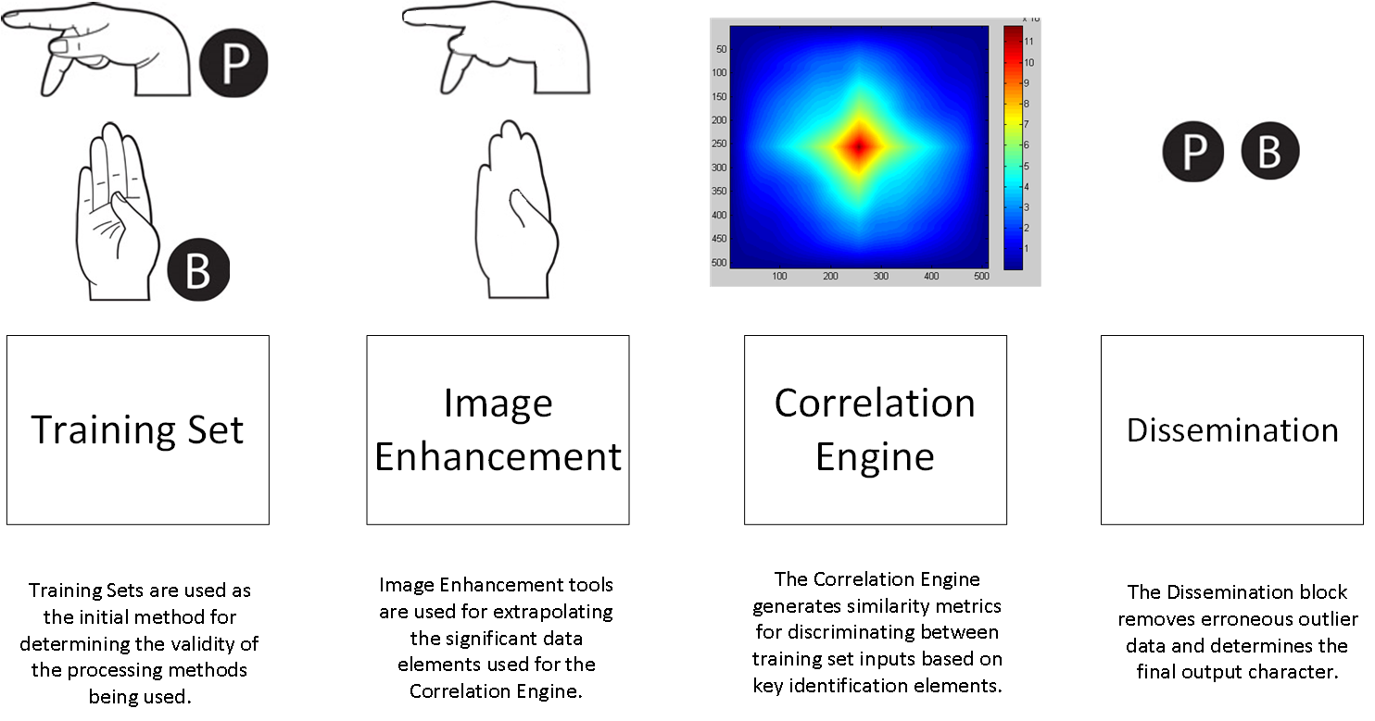
Technical Layout Pt.1

Slide 9
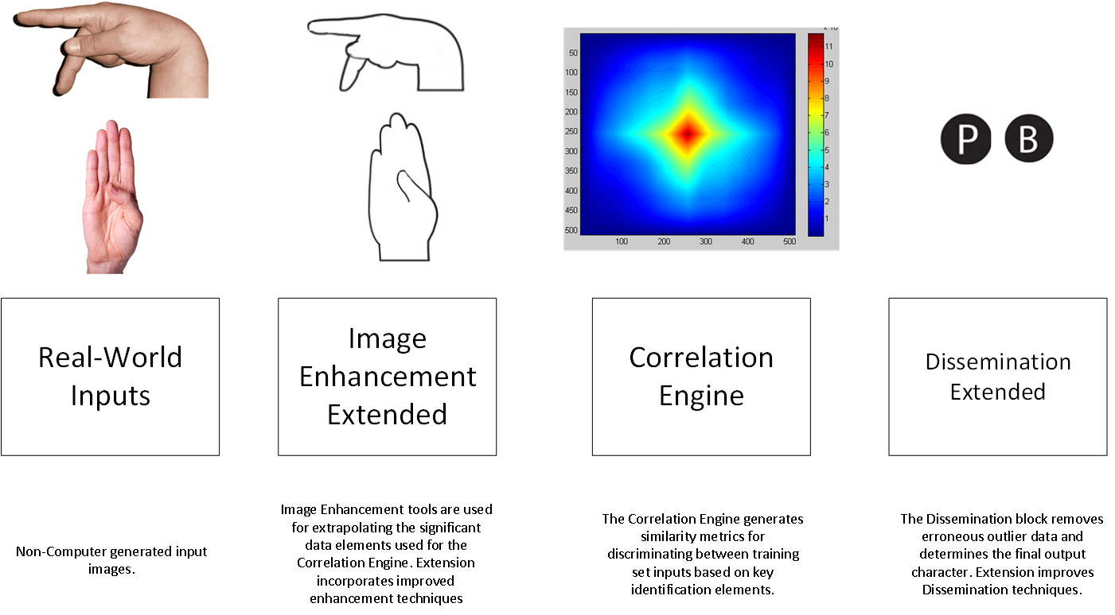
Technical Layout Pt.2

Slide 10
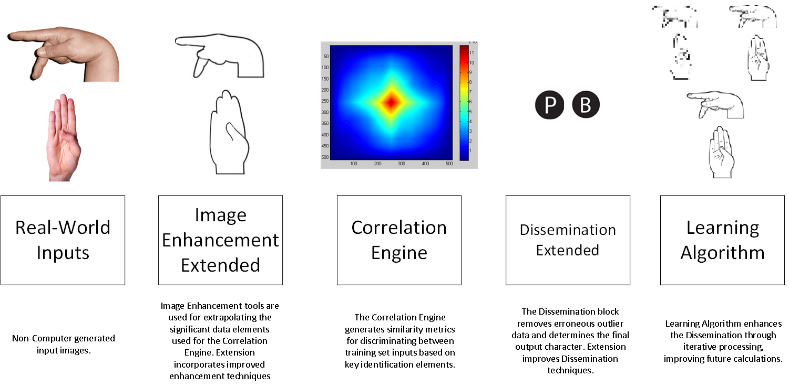
Technical Layout Extended Pt.3/4

Slide 11
Conclusion
Princessosse Irabor
Benjamin Sullins

Slide 12
Additional Slides

Slide 13
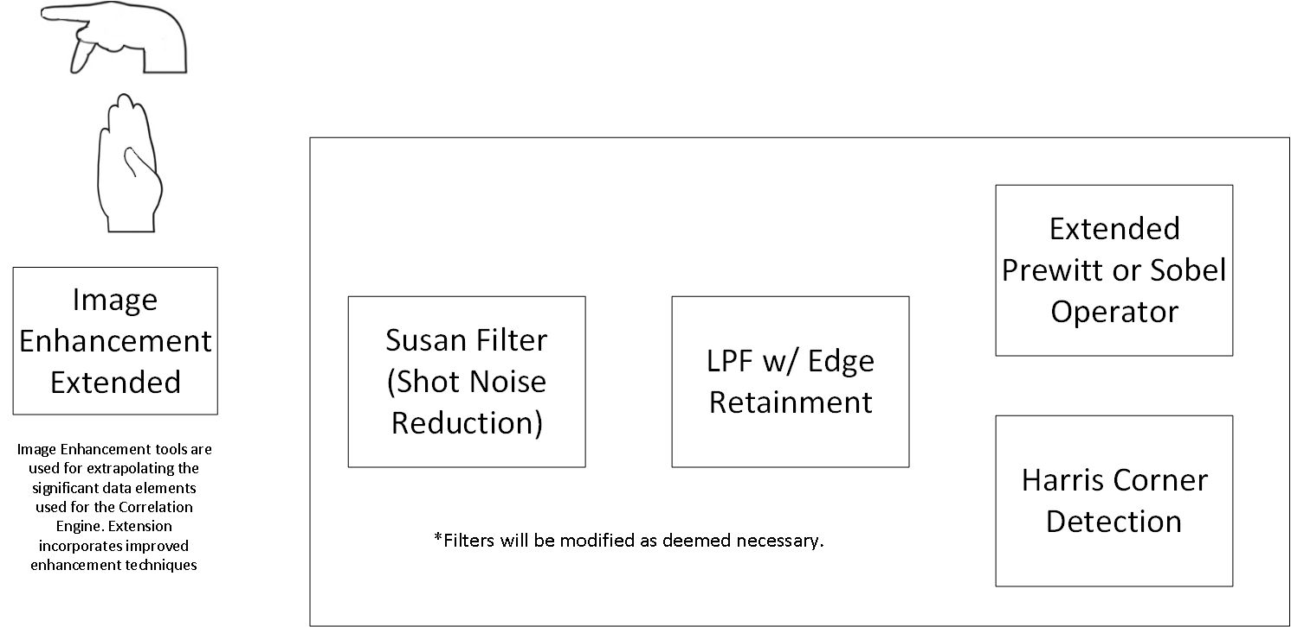
Image Enhancement

Slide 14
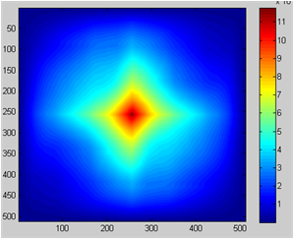
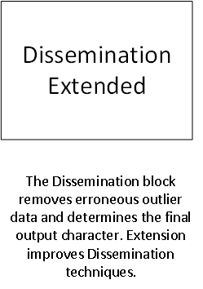
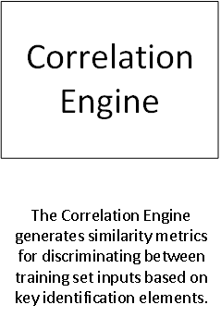

Correlation & Dissemination
Fast Cross-Correlation Algorithm Implementation
Multiple Input
Outlier Removal
Final Character Selection

Slide 15
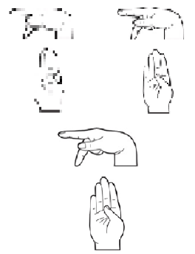
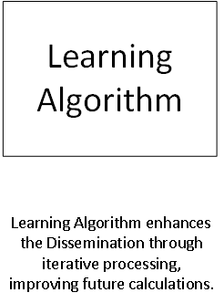
Extra: Learning Algorithm
Heuristic Algorithm
Iterative Based

